Slide 1

Networks & Security Lecture-2
www.corvit.com

Slide 2
Topics
Principles of Network Applications
Http/s
Cookies
Web Caches
Electronic Mail (SMTP, POP3,IMAP)
DNS
FTP/s FTP
www.corvit.com

Slide 3
Processes Communicating
process: program running within a host
within same host, two processes communicate using inter-process communication (defined by OS)
processes in different hosts communicate by exchanging messages
clients, servers
client process: process that initiates communication
server process: process that waits to be contacted
aside: applications with P2P architectures have client processes & server processes
www.corvit.com

Slide 4

Sockets
process sends/receives messages to/from its socket
socket analogous to door
sending process shoves message out door
sending process relies on transport infrastructure on other side of door to deliver message to socket at receiving process
application
socket
application
controlled by
app developer
process
process
transport
transport
network
network
controlled
by OS
link
Internet
link
physical
physical
www.corvit.com

Slide 5
Addressing Processes
to receive messages, process must have identifier
host device has unique 32-bit IP address
Q: does IP address of host on which process runs suffice for identifying the process?
identifier includes both IP address and port numbers associated with process on host.
example port numbers:
HTTP server: 80
mail server: 25
to send HTTP message to gaia.cs.umass.edu web server:
IP address: 128.119.245.12
port number: 80
more shortly…
A: no, many processes can be running on same host
www.corvit.com

Slide 6
App-Layer Protocol Defines
types of messages exchanged,
e.g., request, response
message syntax:
what fields in messages & how fields are delineated
message semantics
meaning of information in fields
rules for when and how processes send & respond to messages
open protocols:
defined in RFCs
allows for interoperability
e.g., HTTP, SMTP
proprietary protocols:
e.g., Skype
www.corvit.com

Slide 7
What Transport Service Does An App Need?
data integrity
some apps (e.g., file transfer, web transactions) require 100% reliable data transfer
other apps (e.g., audio) can tolerate some loss
throughput
some apps (e.g., multimedia) require minimum amount of throughput to be “effective”
other apps (“elastic apps”) make use of whatever throughput they get
timing
some apps (e.g., Internet telephony, interactive games) require low delay to be “effective”
security
encryption, data integrity, …
www.corvit.com

Slide 8
Internet Transport Protocols Services
TCP service:
reliable transport between sending and receiving process
flow control: sender won’t overwhelm receiver
congestion control: throttle sender when network overloaded
does not provide: timing, minimum throughput guarantee, security
connection-oriented: setup required between client and server processes
UDP service:
unreliable data transfer between sending and receiving process
does not provide: reliability, flow control, congestion control, timing, throughput guarantee, security, or connection setup,
Q: why bother? Why is there a UDP?
www.corvit.com

Slide 9
Internet Apps: Application, Transport Protocols
application
layer protocol
SMTP [RFC 2821]
Telnet [RFC 854]
HTTP [RFC 2616]
FTP [RFC 959]
HTTP (e.g., YouTube), RTP [RFC 1889]
SIP, RTP, proprietary
(e.g., Skype)
underlying
transport protocol
TCP
TCP
TCP
TCP
TCP or UDP
TCP or UDP
application
e-mail
remote terminal access
Web
file transfer
streaming multimedia
Internet telephony
www.corvit.com

Slide 10
Securing TCP
TCP & UDP
no encryption
cleartext passwds sent into socket traverse Internet in cleartext
SSL
provides encrypted TCP connection
data integrity
end-point authentication
SSL is at app layer
apps use SSL libraries, that “talk” to TCP
SSL socket API
cleartext passwords sent into socket traverse Internet encrypted
www.corvit.com

Slide 11
Web And HTTP
First, a review…
web page consists of objects
object can be HTML file, JPEG image, Java applet, audio file,…
web page consists of base HTML-file which includes several referenced objects
each object is addressable by a URL, e.g.,
www.someschool.edu/someDept/pic.gif
host name
path name
www.corvit.com

Slide 12

HTTP Overview
HTTP: hypertext transfer protocol
Web’s application layer protocol
client/server model
client: browser that requests, receives, (using HTTP protocol) and “displays” Web objects
server: Web server sends (using HTTP protocol) objects in response to requests
HTTP request
PC running
Firefox browser
HTTP response
HTTP request
server
running
Apache Web
server
HTTP response
iPhone running
Safari browser
www.corvit.com

Slide 13
HTTP Overview (Continued)
uses TCP:
client initiates TCP connection (creates socket) to server, port 80
server accepts TCP connection from client
HTTP messages (application-layer protocol messages) exchanged between browser (HTTP client) and Web server (HTTP server)
TCP connection closed
HTTP is “stateless”
server maintains no information about past client requests
aside
protocols that maintain “state” are complex!
past history (state) must be maintained
if server/client crashes, their views of “state” may be inconsistent, must be reconciled
www.corvit.com

Slide 14
HTTP Connections
non-persistent HTTP
at most one object sent over TCP connection
connection then closed
downloading multiple objects required multiple connections
persistent HTTP
multiple objects can be sent over single TCP connection between client, server
www.corvit.com

Slide 15
Non-Persistent HTTP
suppose user enters URL:
www.someSchool.edu/someDepartment/home.index
1a. HTTP client initiates TCP connection to HTTP server (process) at www.someSchool.edu on port 80
1b. HTTP server at host www.someSchool.edu waiting for TCP connection at port 80. “accepts” connection, notifying client
2. HTTP client sends HTTP request message (containing URL) into TCP connection socket. Message indicates that client wants object someDepartment/home.index
3. HTTP server receives request message, forms response message containing requested object, and sends message into its socket
time
www.corvit.com

Slide 16
Non-Persistent HTTP (Cont.)
4. HTTP server closes TCP connection.
5. HTTP client receives response message containing html file, displays html. Parsing html file, finds 10 referenced jpeg objects
time
6. Steps 1-5 repeated for each of 10 jpeg objects
www.corvit.com

Slide 17
Non-Persistent HTTP: Response Time
RTT (definition): time for a small packet to travel from client to server and back
HTTP response time:
one RTT to initiate TCP connection
one RTT for HTTP request and first few bytes of HTTP response to return
file transmission time
non-persistent HTTP response time =
2RTT+ file transmission time
initiate TCP
connection
RTT
request
file
RTT
time to
transmit
file
file
received
time
time
www.corvit.com

Slide 18
Persistent HTTP
non-persistent HTTP issues:
requires 2 RTTs per object
OS overhead for each TCP connection
browsers often open parallel TCP connections to fetch referenced objects
persistent HTTP:
server leaves connection open after sending response
subsequent HTTP messages between same client/server sent over open connection
client sends requests as soon as it encounters a referenced object
as little as one RTT for all the referenced objects
www.corvit.com

Slide 19
HTTP Request Message
two types of HTTP messages: request, response
HTTP request message:
ASCII (human-readable format)
carriage return character
request line
(GET, POST,
HEAD commands)
line-feed character
GET /index.html HTTP/1.1\r\n
Host: www-net.cs.umass.edu\r\n
User-Agent: Firefox/3.6.10\r\n
Accept: text/html,application/xhtml+xml\r\n
Accept-Language: en-us,en;q=0.5\r\n
Accept-Encoding: gzip,deflate\r\n
Accept-Charset: ISO-8859-1,utf-8;q=0.7\r\n
Keep-Alive: 115\r\n
Connection: keep-alive\r\n
\r\n
header
lines
carriage return,
line feed at start
of line indicates
end of header lines
* Check out the online interactive exercises for more examples: http://gaia.cs.umass.edu/kurose_ross/interactive/
www.corvit.com

Slide 20
HTTP Request Message: General Format
sp
version
cr
request
line
method
URL
sp
lf
value
cr
header field name
lf
~
~
header
lines
~
~
header field name
value
cr
lf
cr
lf
~
entity body
~
body
~
~
www.corvit.com

Slide 21
Uploading Form Input
POST method:
web page often includes form input
input is uploaded to server in entity body
URL method:
uses GET method
input is uploaded in URL field of request line:
www.corvit.com

Slide 22
Method Types
HTTP/1.0:
GET
POST
HEAD
asks server to leave requested object out of response
HTTP/1.1:
GET, POST, HEAD
PUT
uploads file in entity body to path specified in URL field
DELETE
deletes file specified in the URL field
www.corvit.com

Slide 23
HTTP Response Message
status line
(protocol
status code
status phrase)
HTTP/1.1 200 OK\r\n
Date: Sun, 26 Sep 2010 20:09:20 GMT\r\n
Server: Apache/2.0.52 (CentOS)\r\n
Last-Modified: Tue, 30 Oct 2007 17:00:02 GMT\r\n
ETag: "17dc6-a5c-bf716880"\r\n
Accept-Ranges: bytes\r\n
Content-Length: 2652\r\n
Keep-Alive: timeout=10, max=100\r\n
Connection: Keep-Alive\r\n
Content-Type: text/html; charset=ISO-8859-1\r\n
\r\n
data data data data data ...
header
lines
data, e.g.,
requested
HTML file
* Check out the online interactive exercises for more examples: http://gaia.cs.umass.edu/kurose_ross/interactive/
www.corvit.com

Slide 24
HTTP Response Status Codes
status code appears in 1st line in server-to-client response message.
some sample codes:
200 OK
request succeeded, requested object later in this msg
301 Moved Permanently
requested object moved, new location specified later in this msg (Location:)
400 Bad Request
request msg not understood by server
404 Not Found
requested document not found on this server
505 HTTP Version Not Supported
www.corvit.com

Slide 25
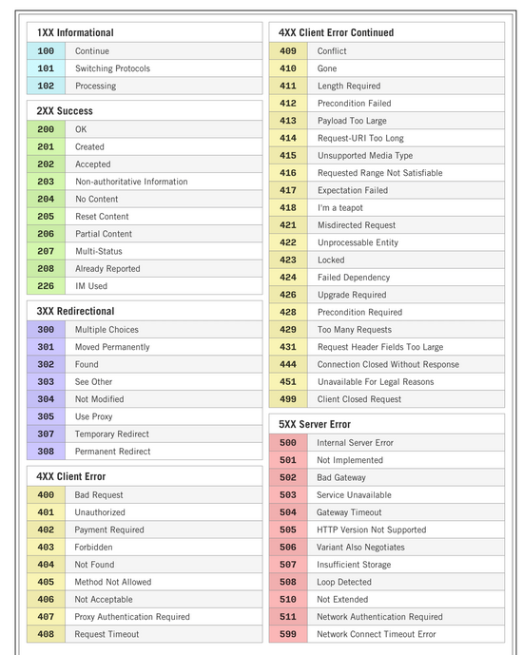
Http Response Errors/Status
www.corvit.com

Slide 26
User-Server State: Cookies
example:
Susan always access Internet from PC
visits specific e-commerce site for first time
when initial HTTP requests arrives at site, site creates:
unique ID
entry in backend database for ID
many Web sites use cookies
four components:
1) cookie header line of HTTP response message
2) cookie header line in next HTTP request message
3) cookie file kept on user’s host, managed by user’s browser
4) back-end database at Web site
www.corvit.com

Slide 27
Cookies: Keeping “State” (Cont.)
client
server
ebay 8734
usual http request msg
Amazon server
creates ID
1678 for user
cookie file
usual http response
set-cookie: 1678
backend
database
create
entry
ebay 8734
amazon 1678
usual http request msg
cookie: 1678
cookie-
specific
action
access
usual http response msg
one week later:
access
ebay 8734
amazon 1678
usual http request msg
cookie: 1678
cookie-
specific
action
usual http response msg
www.corvit.com

Slide 28
Cookies (Continued)
aside
what cookies can be used for:
authorization
shopping carts
recommendations
user session state (Web e-mail)
cookies and privacy:
cookies permit sites to learn a lot about you
you may supply name and e-mail to sites
how to keep “state”:
protocol endpoints: maintain state at sender/receiver over multiple transactions
cookies: http messages carry state
www.corvit.com

Slide 29

Web Caches (Proxy Server)
goal: satisfy client request without involving origin server
user sets browser: Web accesses via cache
browser sends all HTTP requests to cache
object in cache: cache returns object
else cache requests object from origin server, then returns object to client
proxy
server
HTTP request
HTTP request
client
origin
server
HTTP response
HTTP response
HTTP request
HTTP response
client
origin
server
www.corvit.com

Slide 30
More About Web Caching
cache acts as both client and server
server for original requesting client
client to origin server
typically cache is installed by ISP (university, company, residential ISP)
Why Web Caching?
reduce response time for client request
reduce traffic on an institution’s access link
Internet dense with caches: enables “poor” content providers to effectively deliver content (so too does P2P file sharing)
www.corvit.com

Slide 31

Caching Example:
assumptions:
avg object size: 100K bits
avg request rate from browsers to origin servers:15/sec
avg data rate to browsers: 1.50 Mbps
RTT from institutional router to any origin server: 2 sec
access link rate: 1.54 Mbps
consequences:
LAN utilization: 15%
access link utilization = 99%
total delay = Internet delay + access delay + LAN delay
= 2 sec + minutes + usecs
origin
servers
public
Internet
1.54 Mbps
access link
institutional
network
1 Gbps LAN
problem!
www.corvit.com

Slide 32
Caching Example: Fatter Access Link
assumptions:
avg object size: 100K bits
avg request rate from browsers to origin servers:15/sec
avg data rate to browsers: 1.50 Mbps
RTT from institutional router to any origin server: 2 sec
access link rate: 1.54 Mbps
consequences:
LAN utilization: 15%
access link utilization = 99%
total delay = Internet delay + access delay + LAN delay
= 2 sec + minutes + usecs
origin
servers
public
Internet
154 Mbps
1.54 Mbps
access link
154 Mbps
institutional
network
1 Gbps LAN
9.9%
msecs
Cost: increased access link speed (not cheap!)
www.corvit.com

Slide 33
Caching Example: Install local Cache
assumptions:
avg object size: 100K bits
avg request rate from browsers to origin servers:15/sec
avg data rate to browsers: 1.50 Mbps
RTT from institutional router to any origin server: 2 sec
access link rate: 1.54 Mbps
consequences:
LAN utilization: 15%
access link utilization = 100%
total delay = Internet delay + access delay + LAN delay
= 2 sec + minutes + usecs
origin
servers
public
Internet
1.54 Mbps
access link
institutional
network
1 Gbps LAN
local web
cache
How to compute link
utilization, delay?
Cost: web cache (cheap!)
www.corvit.com

Slide 34
Caching Example: Install local Cache
Calculating access link utilization, delay with cache:
suppose cache hit rate is 0.4
40% requests satisfied at cache, 60% requests satisfied at origin
origin
servers
public
Internet
access link utilization:
60% of requests use access link
data rate to browsers over access link
= 0.6*1.50 Mbps = .9 Mbps
utilization = 0.9/1.54 = .58
1.54 Mbps
access link
institutional
network
total delay
= 0.6 * (delay from origin servers) +0.4 * (delay when satisfied at cache)
= 0.6 (2.01) + 0.4 (~msecs) = ~ 1.2 secs
less than with 154 Mbps link (and cheaper too!)
1 Gbps LAN
local web
cache
www.corvit.com

Slide 35
Electronic Mail
outgoing
message queue
user mailbox
Three Major Components:
user agents
mail servers
simple mail transfer protocol: SMTP
User Agent
a.k.a. “mail reader”
composing, editing, reading mail messages
e.g., Outlook, Thunderbird, iPhone mail client
outgoing, incoming messages stored on server
user
agent
mail
server
user
agent
SMTP
mail
server
user
agent
SMTP
SMTP
user
agent
mail
server
user
agent
user
agent
www.corvit.com

Slide 36
Electronic Mail: Mail Servers
mail servers:
mailbox contains incoming messages for user
message queue of outgoing (to be sent) mail messages
SMTP protocol between mail servers to send email messages
client: sending mail server
“server”: receiving mail server
user
agent
mail
server
user
agent
SMTP
mail
server
user
agent
SMTP
SMTP
user
agent
mail
server
user
agent
user
agent
www.corvit.com

Slide 37
Electronic Mail: SMTP [RFC 2821]
uses TCP to reliably transfer email message from client to server, port 25
direct transfer: sending server to receiving server
three phases of transfer
handshaking (greeting)
transfer of messages
closure
command/response interaction (like HTTP)
commands: ASCII text
response: status code and phrase
messages must be in 7-bit ASCI
www.corvit.com

Slide 38


Scenario: Alice Sends Message To Bob
1) Alice uses UA to compose message “to” bob@someschool.edu
2) Alice’s UA sends message to her mail server; message placed in message queue
3) client side of SMTP opens TCP connection with Bob’s mail server
4) SMTP client sends Alice’s message over the TCP connection
5) Bob’s mail server places the message in Bob’s mailbox
6) Bob invokes his user agent to read message
user
agent
mail
server
user
agent
1
mail
server
2
3
6
4
Alice’s mail server
5
Bob’s mail server
www.corvit.com

Slide 39
SMTP: Final Words
SMTP uses persistent connections
SMTP requires message (header & body) to be in 7-bit ASCII
SMTP server uses CRLF.CRLF to determine end of message
comparison with HTTP:
HTTP: pull
SMTP: push
both have ASCII command/response interaction, status codes
HTTP: each object encapsulated in its own response message
SMTP: multiple objects sent in multipart message
www.corvit.com

Slide 40
Mail Message Format
SMTP: protocol for exchanging email messages
RFC 822: standard for text message format:
header lines, e.g.,
To:
From:
Subject:
different from SMTP MAIL FROM, RCPT TO: commands!
Body: the “message”
ASCII characters only
header
blank
line
body
www.corvit.com

Slide 41
Mail Access Protocols
user
agent
mail access
protocol
user
agent
SMTP
SMTP
(e.g., POP,
IMAP)
sender’s mail
server
receiver’s mail
server
SMTP: delivery/storage to receiver’s server
mail access protocol: retrieval from server
POP: Post Office Protocol [RFC 1939]: authorization, download
IMAP: Internet Mail Access Protocol [RFC 1730]: more features, including manipulation of stored messages on server
HTTP: gmail, Hotmail, Yahoo! Mail, etc.
www.corvit.com

Slide 42
POP3 Protocol
S: +OK POP3 server ready
C: user bob
S: +OK
C: pass hungry
S: +OK user successfully logged on
authorization phase
client commands:
user: declare username
pass: password
server responses
+OK
-ERR
transaction phase, client:
list: list message numbers
retr: retrieve message by number
dele: delete
quit
C: list
S: 1 498
S: 2 912
S: .
C: retr 1
S: <message 1 contents>
S: .
C: dele 1
C: retr 2
S: <message 1 contents>
S: .
C: dele 2
C: quit
S: +OK POP3 server signing off
www.corvit.com

Slide 43
POP3 (More) And IMAP
more about POP3
previous example uses POP3 “download and delete” mode
Bob cannot re-read e-mail if he changes client
POP3 “download-and-keep”: copies of messages on different clients
POP3 is stateless across sessions
IMAP
keeps all messages in one place: at server
allows user to organize messages in folders
keeps user state across sessions:
names of folders and mappings between message IDs and folder name
www.corvit.com

Slide 44
DNS: Domain Name System
people: many identifiers:
SSN, name, passport #
Internet hosts, routers:
IP address (32 bit) - used for addressing datagrams
“name”, e.g., www.yahoo.com - used by humans
Q: how to map between IP address and name, and vice versa ?
Domain Name System:
distributed database implemented in hierarchy of many name servers
application-layer protocol: hosts, name servers communicate to resolve names (address/name translation)
note: core Internet function, implemented as application-layer protocol
complexity at network’s “edge”
www.corvit.com

Slide 45
DNS: Services, Structure
DNS Services
hostname to IP address translation
host aliasing
canonical, alias names
mail server aliasing
load distribution
replicated Web servers: many IP addresses correspond to one name
Why Not Centralize DNS?
single point of failure
traffic volume
distant centralized database
maintenance
A: doesn‘t scale!
www.corvit.com

Slide 46
DNS: A Distributed, Hierarchical Database
Root DNS Servers
…
…
com DNS servers
org DNS servers
edu DNS servers
yahoo.com
DNS servers
pbs.org
DNS servers
poly.edu
DNS servers
umass.edu
DNS servers
amazon.com
DNS servers
client wants IP for www.amazon.com; 1st approximation:
client queries root server to find com DNS server
client queries .com DNS server to get amazon.com DNS server
client queries amazon.com DNS server to get IP address for www.amazon.com
www.corvit.com

Slide 47
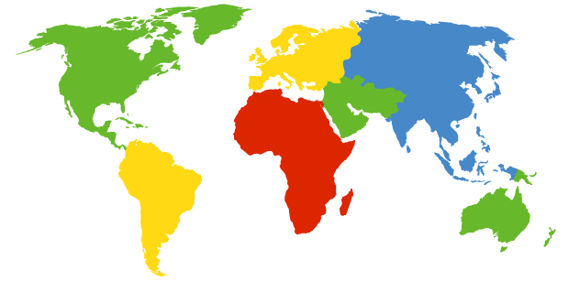
DNS: Root Name Servers
contacted by local name server that can not resolve name
root name server:
contacts authoritative name server if name mapping not known
gets mapping
returns mapping to local name server
c. Cogent, Herndon, VA (5 other sites)
d. U Maryland College Park, MD
h. ARL Aberdeen, MD
j. Verisign, Dulles VA (69 other sites )
k. RIPE London (17 other sites)
i. Netnod, Stockholm (37 other sites)
e. NASA Mt View, CA
f. Internet Software C.
Palo Alto, CA (and 48 other sites)
m. WIDE Tokyo
(5 other sites)
13 logical root name “servers” worldwide
each “server” replicated many times
a. Verisign, Los Angeles CA
(5 other sites)
b. USC-ISI Marina del Rey, CA
l. ICANN Los Angeles, CA
(41 other sites)
g. US DoD Columbus, OH (5 other sites)
www.corvit.com

Slide 48
TLD, Authoritative Servers
top-level domain (TLD) servers:
responsible for com, org, net, edu, aero, jobs, museums, and all top-level country domains, e.g.: uk, fr, ca, jp
Network Solutions maintains servers for .com TLD
Educause for .edu TLD
authoritative DNS servers:
organization’s own DNS server(s), providing authoritative hostname to IP mappings for organization’s named hosts
can be maintained by organization or service provider
www.corvit.com

Slide 49
Local DNS Name Server
does not strictly belong to hierarchy
each ISP (residential ISP, company, university) has one
also called “default name server”
when host makes DNS query, query is sent to its local DNS server
has local cache of recent name-to-address translation pairs (but may be out of date!)
acts as proxy, forwards query into hierarchy
www.corvit.com

Slide 50
DNS Name Resolution Example
root DNS server
2
host at cis.poly.edu wants IP address for gaia.cs.umass.edu
3
TLD DNS server
4
5
iterated query:
contacted server replies with name of server to contact
“I don’t know this name, but ask this server”
local DNS server
dns.poly.edu
7
6
1
8
authoritative DNS server
dns.cs.umass.edu
requesting host
cis.poly.edu
gaia.cs.umass.edu
www.corvit.com

Slide 51
DNS Name Resolution Example
root DNS server
2
3
recursive query:
puts burden of name resolution on contacted name server
heavy load at upper levels of hierarchy?
7
6
TLD DNS
server
local DNS server
dns.poly.edu
5
4
1
8
authoritative DNS server
dns.cs.umass.edu
requesting host
cis.poly.edu
gaia.cs.umass.edu
www.corvit.com

Slide 52
DNS: Caching, Updating Records
once (any) name server learns mapping, it caches mapping
cache entries timeout (disappear) after some time (TTL)
TLD servers typically cached in local name servers
thus root name servers not often visited
cached entries may be out-of-date (best effort name-to-address translation!)
if name host changes IP address, may not be known Internet-wide until all TTLs expire
update/notify mechanisms proposed IETF standard
RFC 2136
www.corvit.com

Slide 53
DNS Records
DNS: distributed database storing resource records (RR)
RR format: (name, value, type, ttl)
type=A
name is hostname
value is IP address
type=CNAME
name is alias name for some “canonical” (the real) name
www.ibm.com is really
servereast.backup2.ibm.com
value is canonical name
type=NS
name is domain (e.g., foo.com)
value is hostname of authoritative name server for this domain
type=MX
value is name of mailserver associated with name
www.corvit.com

Slide 54
DNS Protocol, Messages
query and reply messages, both with same message format
2 bytes
2 bytes
message header
identification: 16 bit # for query, reply to query uses same #
flags:
query or reply
recursion desired
recursion available
reply is authoritative
identification
flags
# questions
# answer RRs
# authority RRs
# additional RRs
questions (variable # of questions)
answers (variable # of RRs)
authority (variable # of RRs)
additional info (variable # of RRs)
www.corvit.com

Slide 55
DNS Protocol, Messages
2 bytes
2 bytes
identification
flags
# questions
# answer RRs
# authority RRs
# additional RRs
name, type fields
for a query
questions (variable # of questions)
RRs in response
to query
answers (variable # of RRs)
records for
authoritative servers
authority (variable # of RRs)
additional “helpful”
info that may be used
additional info (variable # of RRs)
www.corvit.com

Slide 56
Inserting Records Into DNS
example: new startup “Network Utopia”
register name networkuptopia.com at DNS registrar (e.g., Network Solutions)
provide names, IP addresses of authoritative name server (primary and secondary)
registrar inserts two RRs into .com TLD server: (networkutopia.com, dns1.networkutopia.com, NS)
(dns1.networkutopia.com, 212.212.212.1, A)
create authoritative server type A record for www.networkuptopia.com; type MX record for networkutopia.com
www.corvit.com

Slide 57
Attacking DNS
DDoS Attacks
bombard root servers with traffic
not successful to date
traffic filtering
local DNS servers cache IPs of TLD servers, allowing root server bypass
bombard TLD servers
potentially more dangerous
redirect attacks
man-in-middle
Intercept queries
DNS poisoning
Send bogus relies to DNS server, which caches
exploit DNS for DDoS
send queries with spoofed source address: target IP
requires amplification
www.corvit.com

Slide 58
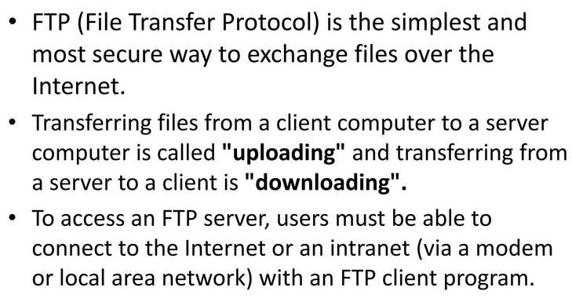
FTP (File Transfer Protocol)
www.corvit.com

Slide 59
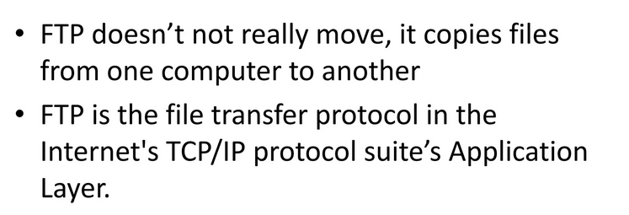
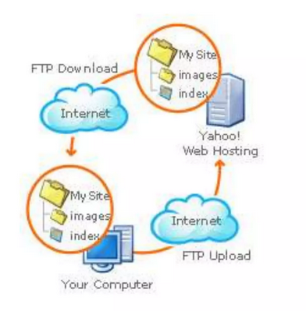
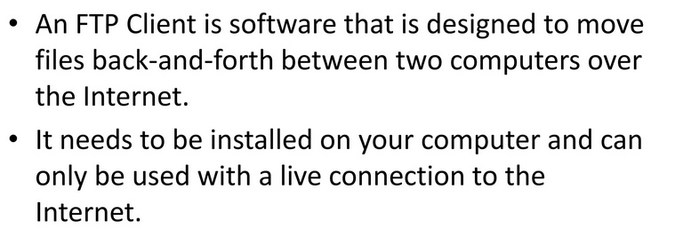
File Transfer Protocol
www.corvit.com

Slide 60
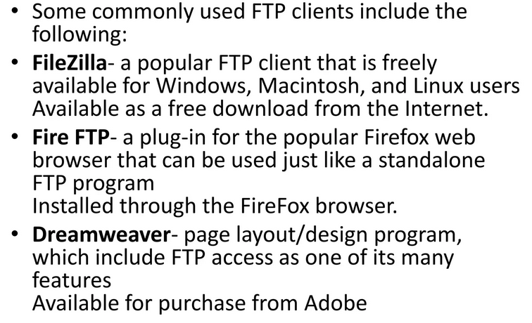
FTP Clients
www.corvit.com

Slide 61
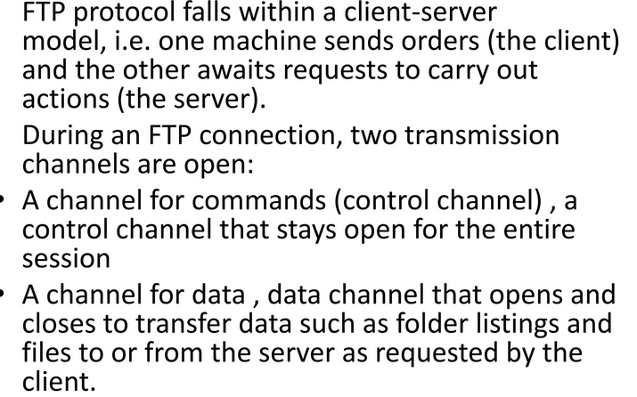
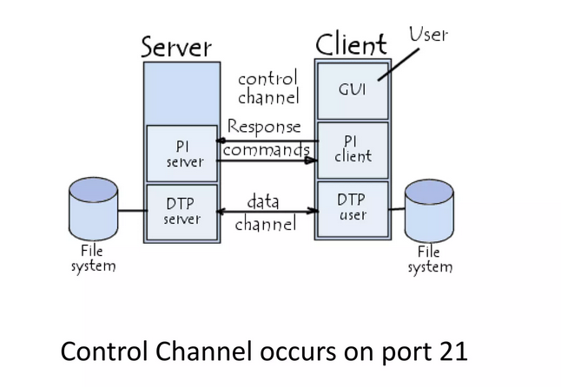
FTP Model
www.corvit.com

Slide 62
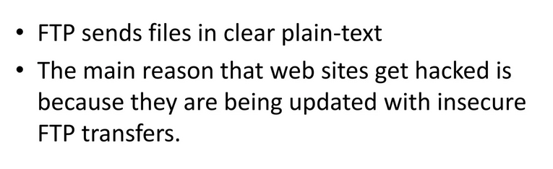
Problems With FTP
www.corvit.com

Slide 63
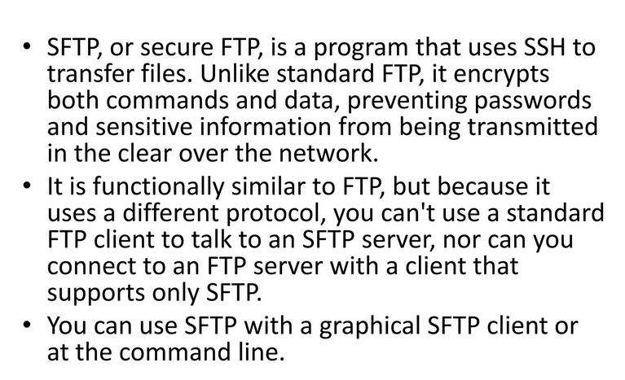
Secure FTP
www.corvit.com

Slide 64
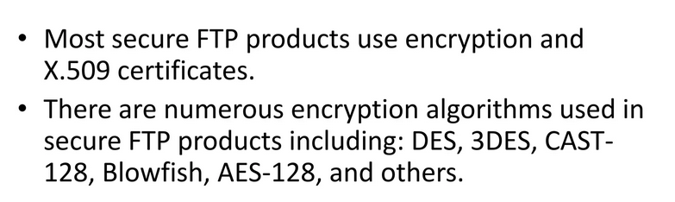
Secure FTP
www.corvit.com

